Slide 1



Parental HIV Disclosure: Scoping Literature Review with a Lens on Information Behavior
Katie Veeninga, MLIS, PhD Student
School of Information, Dominican University

Slide 2
Defining Disclosure
“something (such as information) that is made known or revealed
(Britannica Dictionary, n.d., Definition 2)
“the act of making something known or the fact that is made known”
(Cambridge English Dictionary, n.d.)
“the act of parents living with HIV (PLH) telling their children about their HIV diagnosis”
(Da et al., 2024)

Slide 3
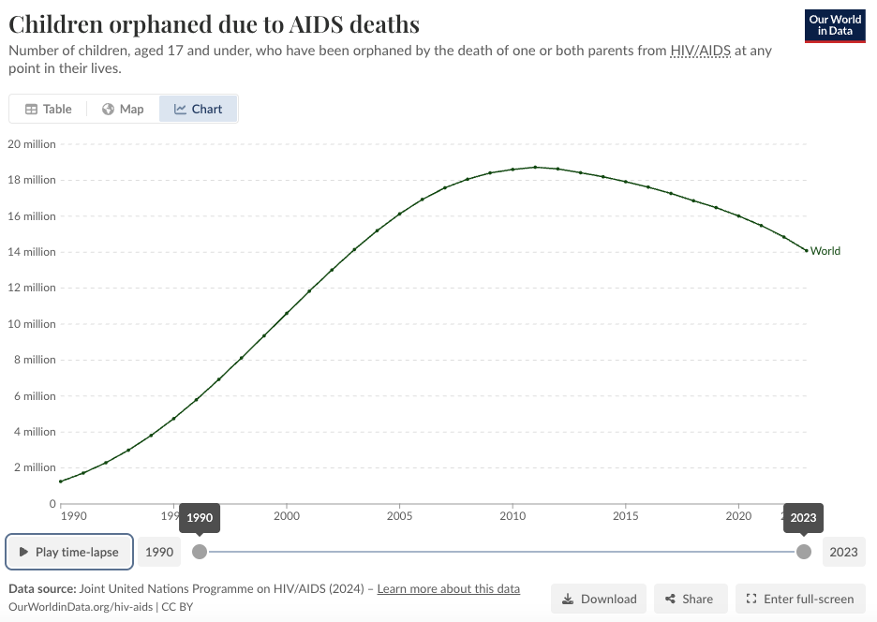
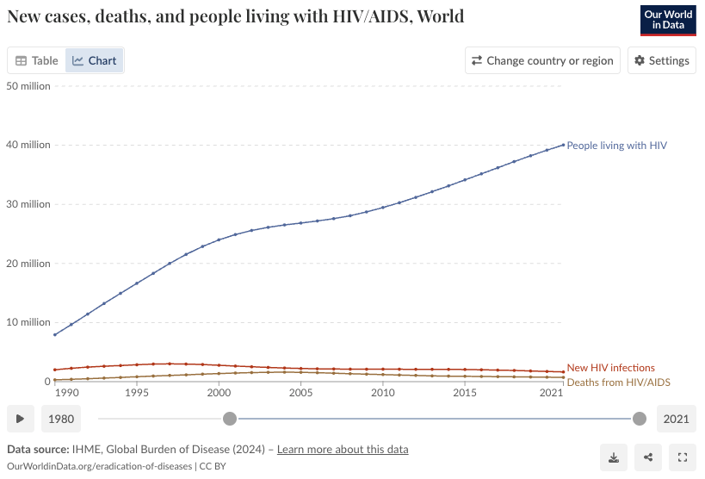
Why Parental Disclosure?
14.1M
40.04M
Figure 1. Children orphaned due to AIDS deaths (Roser & Ritchie, 2023)
Figure 2. New cases, deaths, and people living with HIV/AIDS (Roser & Ritchie, 2023)

Slide 4
Research Questions
Scoping Literature Review
What research has been done about parental HIV disclosure?
How has information behavior theory been applied to research about parental HIV/AIDS disclosure?

Slide 5







Data Set
2002 - 2023
1
1
11
3
Research Studies
1
4
Qualitative Studies
2
2
4
Randomized Controlled Trials
Mixed-methods Studies
1
1
Systematic Literature Review
2

Slide 6

Benefits
Access to greater support as one benefit of disclosure (5)
Reduced stress, anxiety, and/or depression as a benefit of disclosure (4)
Improvement to the parent’s treatment adherence (3)
Better communication within the family (3)
Improvement in the quality of family relationships (3)

Slide 7
Barriers
Fear of negative reactions (4)
Child's age and related ability to understand (3)
Need for more support & knowledge (1)
Causing children worry (3)
Status deserves protection (2)
Anticipation of stigma
Discrimination
Disrespect
HIV
Sex generally
Maintaining confidentially
“…parents were also concerned that a child might be too young to understand confidentiality or how to “keep secrets”
(Cyrus et al., 2023, p. 7).

Slide 8

Interventions
Need for interventions
Actual interventions

Slide 9
Research Gaps
Focus on well-developed countries
Small study sizes
Interventions to promote disclosure
Interventions specific to children’s age & development
Interventions specific to fear of stigma
Limitation of applicability due to social and cultural differences
Lack of research prior to 1993
Variation and minimal sociodemographic data
Lack of theoretical framework

Slide 10
Disclosure as Information Behavior
Avoiding information
Information seeking
How individuals "deal with" information
Purposeful behaviors
Secrecy
Disclosure
Unintentional behaviors
Avoiding information
Encountering information
Glimpsing information

Slide 11
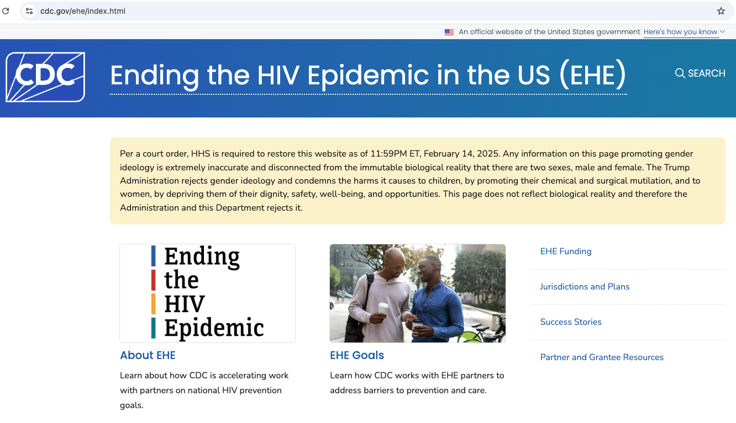
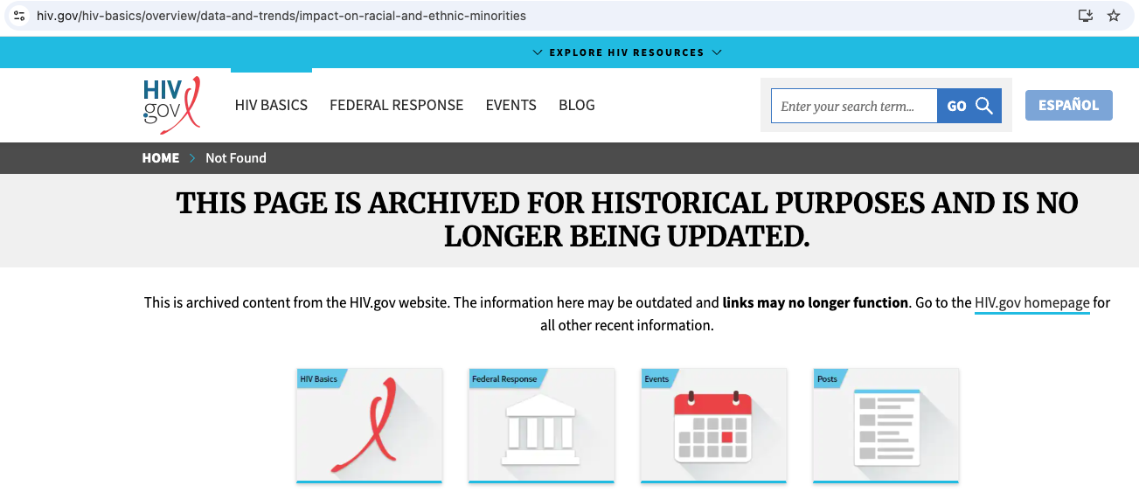
Epilogue
Figure 3. Ending the HIV Epidemic in the US website (CDC, n.d.)
Retrieved May 17, 2025
Figure 4. Impact on racial and ethnic minorities (HHS, 2025)
Retrieved May 17, 2025

Slide 12
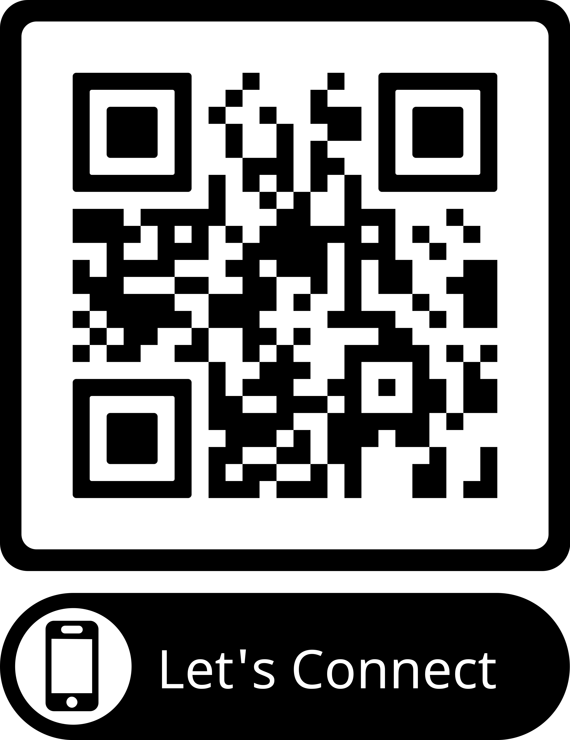
Thank you!
“…the silence in many HIV-affected families may now extend the stigma into the next generation, emotionally burdening both HIV-infected caregivers and HIV-affected children”
(Nostlinger et al., 2004, p. 647)

Slide 13
Presentation References*
Burke, J. (2025, March 28). HHS Staff Cuts. HIV+HEP Policy Institute. https://hivhep.org/press-releases/statement-on-elimination-of-hhs-office-of-infectious-diseases-hiv-policy-other-hhs-staff-cuts/
Cambridge Dictionary. (n.d.). Disclosure. In Cambridge Dictionary. Retrieved September 24, 2024, from https://dictionary.cambridge.org/us/dictionary/english/disclosure
Case, D. & Given, L. (2016). Looking for Information: A Survey of Research on Information Seeking, Needs, and Behavior: Vol. Fourth edition. Emerald Group Publishing Limited. https://search.ebscohost.com/login.aspx?direct=true&AuthType=shib&db=nlebk&AN=1427926&authtype=sso&custid=s8366013&site=ehost-live&scope=site&custid=s8366013
Cyrus, C., Firdawsi, O., Wang, J., Njuguna, I. N., Wamalwa, D. C., Slyker, J. A., John-Stewart, G. C., O’Malley, G., & Wagner, A. D. (2023). “When they are all grown, I will tell them”: Experience and perceptions of parental self-disclosure of HIV status to children in Nairobi, Kenya. BMC Public Health, 23(1), 519–519. https://doi.org/10.1186/s12889-023-15387-3
Da, W., Zhang, R., Zhou, Y., Shen, Z., Qiao, S., & Li, X. (2024). Impact of children’s age on parental HIV disclosure: a parental HIV disclosure intervention among parents living with HIV in China. AIDS Care, 36(sup1), 76–84. https://doi.org/10.1080/09540121.2024.2308744
MedPage Today. (2024, December 18). RFK falsely claims that poppers cause AIDS. [Video]. YouTube. https://youtu.be/7BW8DbOd9wY?si=dwiF6PHHDwA7WZhw
Nöstlinger, C., Jonckheer, T., de Belder, E., van Wijngaerden, E., Wylock, C., Pelgrom, J., & Colebunders, R. (2004). Families affected by HIV: parents’ and children’s characteristics and disclosure to the children. AIDS Care, 16(5), 641–648. https://doi.org/10.1080/09540120410001716432
Roser, M. & Ritchie, H. (2023). Children orphaned due to AIDS. Our world in data. https://ourworldindata.org/grapher/number-of-children-orphaned-from-aids
Roser, M. & Ritchie, H. (2023). HIV / AIDS. Our world in data. https://ourworldindata.org/hiv-aids
The Britannica Dictionary. (n.d.) Disclosure. In The Britannica Dictionary. Retrieved September 24, 2024, from https://www.britannica.com/dictionary/disclosure
U.S. Centers for Disease Control and Prevention. (n.d.) Ending the HIV Epidemic in the US (EHE). U.S. Centers for Disease Control and Prevention. https://www.cdc.gov/ehe/index.html
U.S. Department of Health and Human Services (HHS). (2025, March 20). Impact on racial and ethnic minorities. U.S. Department of Health and Human Services (HHS). https://www.hiv.gov/hiv-basics/overview/data-and-trends/impact-on-racial-and-ethnic-minorities
Wilson, T. D. (1999). Models in information behaviour research. Journal of Documentation, 55(3), 249–270. https://doi.org/10.1108/EUM0000000007145
*All research references can be found in paper

